Slide 1
Unit-4 Designing Interfaces and Dialogues
User-focused activity.
Prototyping methodology of iteratively:
Collecting information.
Constructing a prototype.
Assessing usability.
Making refinements.
Answer the who, what, where, and how questions.

Slide 2
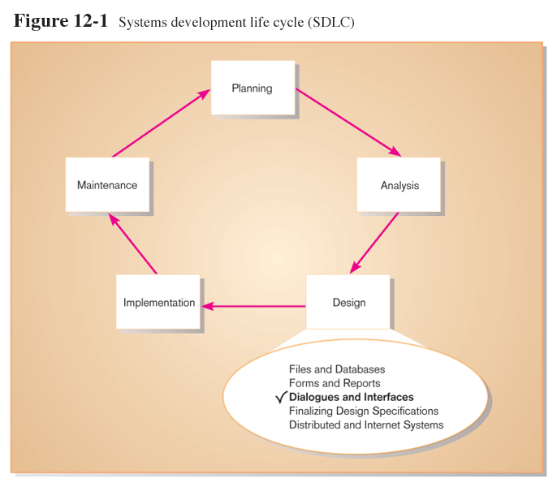
Designing Interfaces and Dialogues (Cont.)

Slide 3
Deliverables and Outcomes
Creation of a design specification.
A typical interface/dialogue design specification is similar to form design, but includes multiple forms and dialogue sequence specifications.

Slide 4
Deliverables and Outcomes (Cont.)
The specification includes:
Narrative overview.
Sample design.
Testing and usability assessment.
Dialogue sequence.
Dialogue sequence is the ways a user can move from one display to another.

Slide 5
Interaction Methods and Devices
Interface: a method by which users interact with an information system.
All human-computer interfaces must:
have an interaction style; and
use some hardware device(s) for supporting this interaction.

Slide 6
Methods of Interacting
Command line
Includes keyboard shortcuts and function keys.
Menu
Form
Object-based
Natural language

Slide 7
Command Language Interaction
Command language interaction: a human-computer interaction method whereby users enter explicit statements into a system to invoke operations.
Example from MS DOS:
COPY C:PAPER.DOC A:PAPER.DOC
This copies a file from C: drive to A: drive.

Slide 8
Menu Interaction
Menu interaction: a human-computer interaction method in which a list of system options is provided and a specific command is invoked by user selection of a menu option.
Pop-up menu: a menu-positioning method that places a menu near the current cursor position.

Slide 9
Menu Interaction (Cont.)
Drop-down menu: a menu-positioning method that places the access point of the menu near the top line of the display:
When accessed, menus open by dropping down onto the display.
Visual editing tools help designers construct menus.

Slide 10
Menu Interaction (Cont.)
Guidelines for Menu Design
Wording: meaningful titles, clear command verbs, mixed upper/lower case.
Organization: consistent organizing principle.
Length: all choices fit within screen length.
Selection: consistent, clear and easy selection methods.
Highlighting: only for selected options or unavailable options.

Slide 11
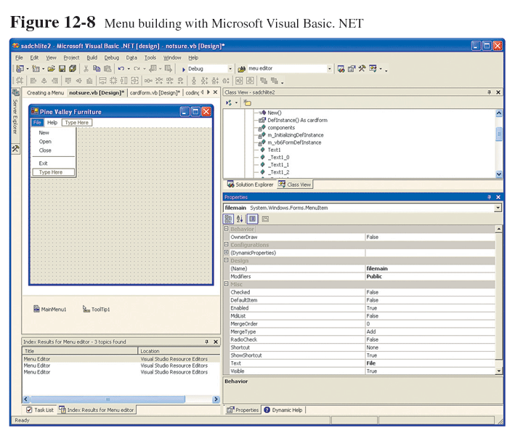
Menu Interaction (Cont.)

Slide 12
Form Interaction
Form interaction: a highly intuitive human-computer interaction method whereby data fields are formatted in a manner similar to paper-based forms.
Allows users to fill in the blanks when working with a system.

Slide 13
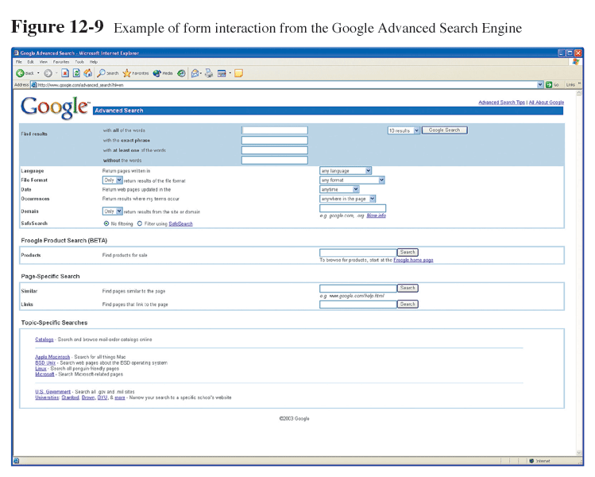
Form Interaction (Cont.)

Slide 14
Object-Based Interaction
Object-based interaction: a human-computer interaction method in which symbols are used to represent commands or functions.
Icons: graphical pictures that represent specific functions within a system.
Use little screen space and are easily understood by users.

Slide 15
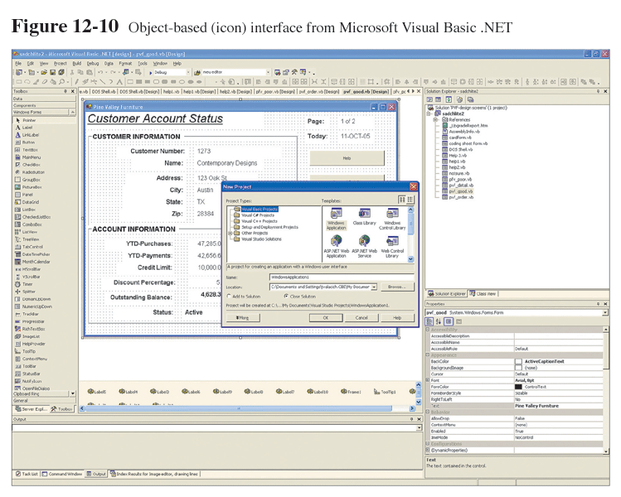
Object-Based Interaction (Cont.)

Slide 16
Natural Language Interaction
Natural language interaction: a human-computer interaction method whereby inputs to and outputs from a computer-based application are in a conventional spoken language such as English.
Based on research in artificial intelligence.
Current implementations are tedious and difficult to work with, not as viable as other interaction methods.

Slide 17
Usability Problems with Hardware Devices
Visual Blocking
touch screen, light pen
User Fatigue
touch screen, light pen
Movement Scaling
keyboard, mouse, joystick, trackball, graphics tablet, voice
Durability
trackball, touch screen
Adequate Feedback
keyboard, mouse, joystick, trackball, graphics tablet, voice
Speed
keyboard
Pointing Accuracy
joystick, touch screen, light pen, voice

Slide 18
Natural Language Interaction (Cont.)
Usability problems with hardware devices:
Visual Blocking
touch screen, light pen.
User Fatigue
touch screen, light pen.

Slide 19
Natural Language Interaction (Cont.)
Movement Scaling
keyboard, mouse, joystick, trackball, graphics tablet, voice.
Durability
trackball, touch screen.

Slide 20
Natural Language Interaction (Cont.)
Adequate Feedback
keyboard, mouse, joystick, trackball, graphics tablet, voice.
Speed
Keyboard.
Pointing Accuracy
joystick, touch screen, light pen, voice.

Slide 21
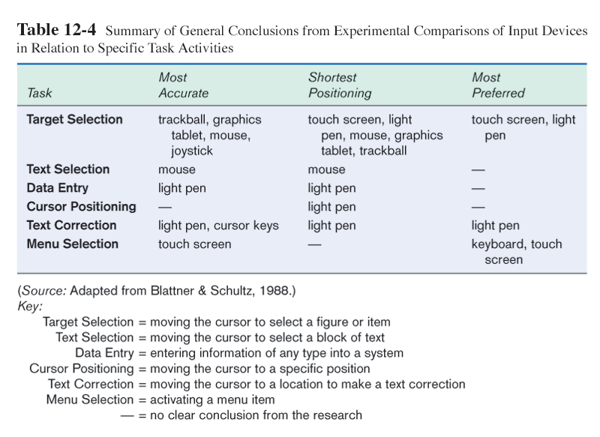
Natural Language Interaction (Cont.)

Slide 22
Designing Interfaces
Forms has several general areas common to most forms:
Header information.
Sequence and time-related information.
Instruction or formatting information.
Body or data details.

Slide 23
Designing Interfaces (Cont.)
Totals or data summary.
Authorization or signatures.
Comments.
Use standard formats similar to paper-based forms and reports.
Left-to-right, top-to-bottom navigation.

Slide 24
Designing Interfaces (Cont.)
Flexibility and consistency:
Free movement between fields.
No permanent data storage until the user requests.
Each key and command assigned to one function.

Slide 25
Structuring Data Entry
Entry | Never require data that are already online or that can be computed
Defaults | Always provide default values when appropriate
Units | Make clear the type of data units requested for entry
Replacement | Use character replacement when appropriate
Captioning | Always place a caption adjacent to fields
Format | Provide formatting examples
Justify | Automatically justify data entries
Help | Provide context-sensitive help when appropriate

Slide 26
Controlling Data Input
Objective: reduce data entry errors.
Common sources data entry errors in a field:
Appending: adding additional characters
Truncating: losing characters
Transcripting: entering invalid data
Transposing: reversing sequence of characters

Slide 27
Providing Feedback
Three types of system feedback:
Status information: keep user informed of what’s going on, helpful when user has to wait for response.
Prompting cues: tell user when input is needed, and how to provide the input.
Error or warning messages: inform user that something is wrong, either with data entry or system operation.

Slide 28
Providing Help
Place yourself in user’s place when designing help.
Guidelines for designing usable help:
Simplicity - Help messages should be short and to the point.
Organize - Information in help messages should be easily absorbed by users
Show - It is useful to explicitly show users how to perform an operation.

Slide 29
Designing Dialogues
Dialogues: the sequence of interaction between a user and a system.
Dialogue design involves:
Designing a dialogue sequence.
Building a prototype.
Assessing usability.

Slide 30
Designing the Dialogue Sequence
Typical dialogue between user and Customer Information System:
Request to view individual customer information.
Specify the customer of interest.
Select the year-to-date transaction summary display.

Slide 31
Designing the Dialogue Sequence (Cont.)
Review the customer information.
Leave system.
Dialogue diagramming: a formal method for designing and representing human-computer dialogues using box and line diagrams.

Slide 32
Designing the Dialogue Sequence (Cont.)
Three sections of the box are used as:
Top: contains a unique display reference number used by other displays for referencing it.
Middle: contains the name or description of the display.
Bottom: contains display reference numbers that can be accessed from the current display.

Slide 33
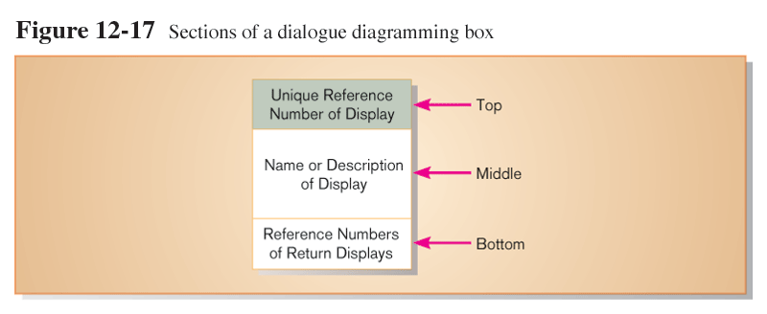
Designing the Dialogue Sequence (Cont.)

Slide 34
Designing the Dialogue Sequence (Cont.)
Dialogue diagrams depict the sequence, conditional branching, and repetition of dialogues.

Slide 35
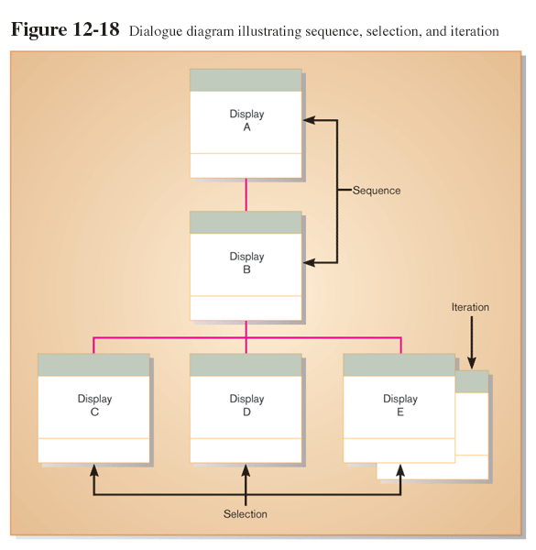
Designing the Dialogue Sequence (Cont.)

Slide 36
Building Prototypes and Assessing Usability
Optional activities.
Building prototypes displays using a graphical development environment.
Microsoft’s Visual Studio .NET
Borland’s Enterprise Studio
Easy-to-use input and output (form, report, or window) design utilities.

Slide 37
Graphical Interface Design Issues
Become an expert user of the GUI environment.
Understand how other applications have been designed.
Understand standards.
Gain an understanding of the available resources and how they can be used.
Become familiar with standards for menus and forms.

Slide 38
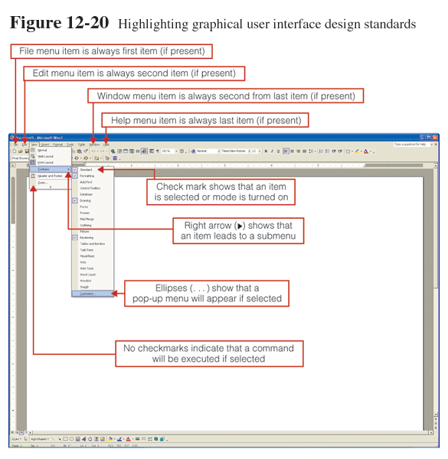
Graphical Interface Design Issues (Cont.)

